Slide 1
GDP Trends in Middle Eastern and Northern Africa(MENA)
Group 3
Mahita Koduru
Rishabh Taneja
Rupam Jogal
Shikhar Chhabra
Shivi Nigam

Slide 2
PLOT “Stats & co” provides economic impact analysis, studies economic development planning, social research and analysis, and strategic planning and program development services to government, non-profit and corporate clients. We are working in collaboration with a Swedish non-profit “fact-tank” organization named Gap-minder Foundation to study the GDP variations in the Middle East and North African countries.

Slide 3
“IS GDP A DRIVER OF THE DEMOGRAPHIC-ECONOMIC CHANGES IN MENA?”
PROBLEM
STATEMENT

Slide 4
The dataset
The dataset has been retrieved from the Gap-Minder foundation’s database on world population metrics.
The dataset consists of 8 variables and 10,011 observations.
The 8 variables are
Countries
Year
Fertility rate
Life Expectancy
Population
Child Mortality
GDP
Region

Slide 5
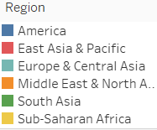
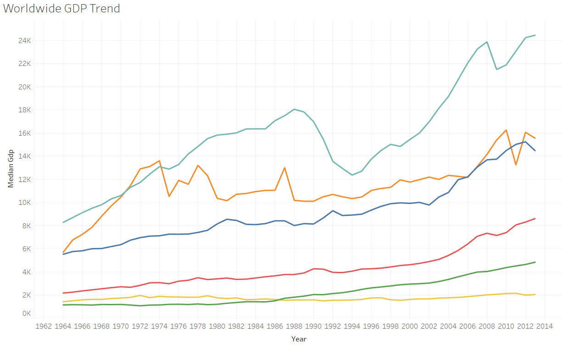
WORLD WIDE GDP TREND
The maximum variations were observed in the Middle Eastern and North African region when compared to the European or the American region.
The dips were observed in the year 2011 in MENA, the reasons will be discovered in the further analysis.

Slide 6
The primary demographic factor which we are considering for the countries in MENA is GDP.
The secondary demographic factors considered are:
1.Child Mortality
2.Life-expectancy
3. Population

Slide 7
BUSINESS QUESTIONS
Does GDP variations affect the Child Mortality rates in the countries of MENA?
How does the GDP of MENA affect it’s Life Expectancy rate?
Are there any population trends with respect to GDP for the middle eastern and north Africa?.

Slide 8
DATA CLEANING
The NULL values were only present in GDP and Child Mortality with a count of 100 and 66 respectively.
Which amounts to 10% of the total data. The NULL values have been filtered in tableau.
Since our problem statement revolves around the Middle Eastern and North African region, we have filtered the values with respect to the desired region.
After the cleaning process, for the MENA region the Western Sahara and Yemen countries were removed due to NULL values in their GDP record

Slide 9
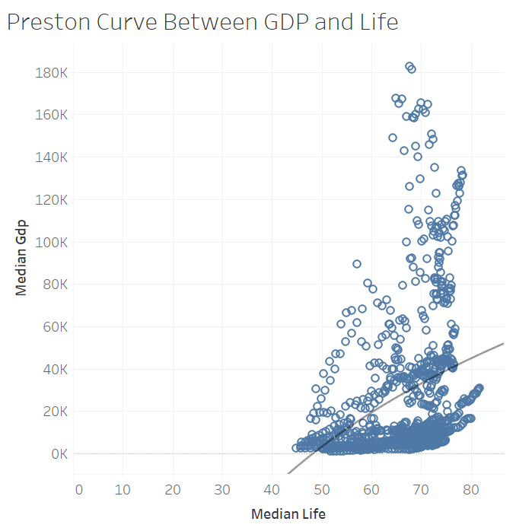
Preston curve
Preston curve is the cross-sectional relationship between life expectancy and actual per capita income which is named after Samuel H. Preston who described the relationship in 1975.
The graph shows a positive correlation as the regression equation has a positive intercept of 88702.3
The trend follows the logarithmic function that fits the expectancy data with R-squared value of 0.108197 which shows 10.81% variation in the median life expectancy.
The p-value < 0.0001 that proves that there is a very little variation in the expectancy due to GDP and is significant.

Slide 10
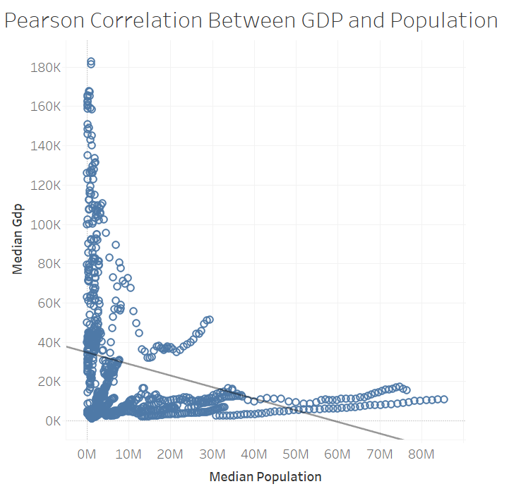
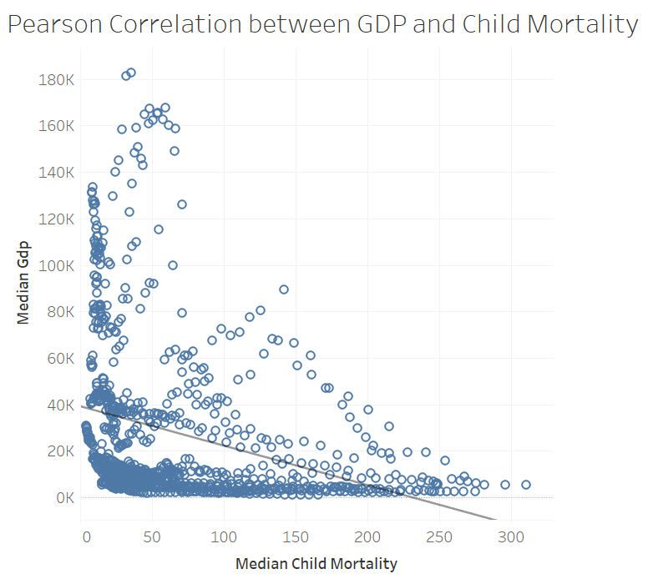
Pearson Correlation
Notes:
The pearson distribution is used for continuous probability distributions produced by Karl Pearson around 1895.
The graph shows a negative correlation as the regression equation has a negative intercept of -169.71
The trend follows the logarithmic function that fits the mortality data with R-squared value of 0.093 which shows 9.3% variation in the median child mortality
The p-value < 0.0001 that proves that there is a very little variation in the mortality due to GDP and is significant.
_____________________________________________________________________________________________________
The graph shows a negative correlation as the regression equation has a negative intercept of -0.00058
The trend follows the logarithmic function that fits the population data with R-squared value of 0.084 which shows 8.4% variation in the median population
The p-value < 0.0001 that proves that there is a very little variation in the population due to GDP and is significant.

Slide 11
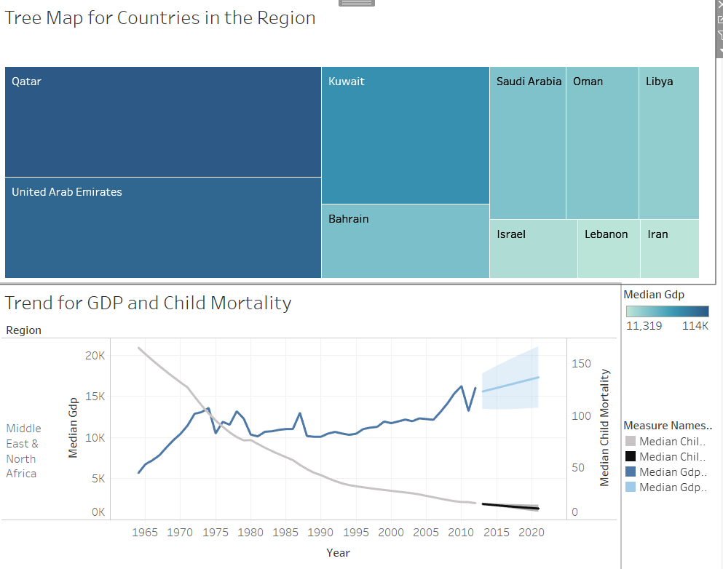
CHILD MORTALITY
Kuwait faced a drop of 50% in the median GDP from the year 1990 to 1991 due the Iraqi invasion
This affected the child mortality as it has increased up to 11% in same years though there is a decreasing trend, the rate of child mortality increases due to the low income levels.
We have predicted the trend in GDP and child mortality for the year 2020. GDP shows a stagnant rate for the coming years whereas the child mortality follows the same decreasing trend for the coming years as well.

Slide 12
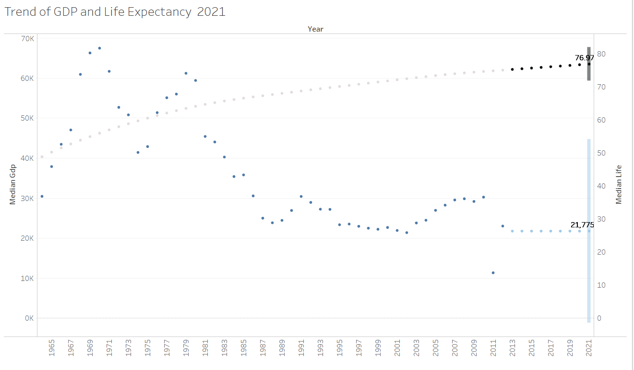
LIFE EXPECTANCY
LIBYA
Libya saw a major drop of 65% in GDP during 2011 due to the civil war.
This affected the growth in life expectancy. Though the life expectancy shows an increasing trend, the rate of life-expectancy decrease with respect to the previous years due to the poverty prevailing during the war period.

Slide 13
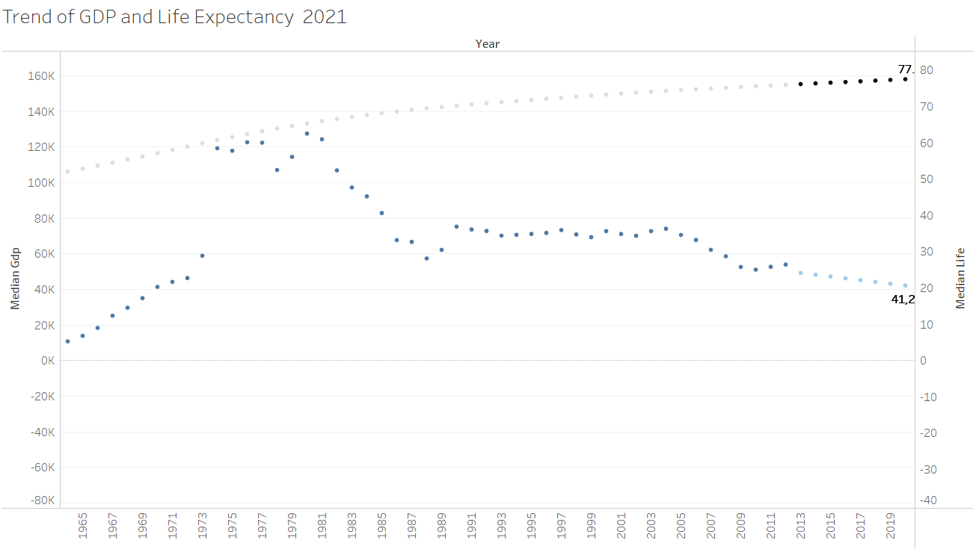
LIFE EXPECTANCY
UAE
UAE sees a downfall in GDP from 2005 due to the deeper recession in the oil & gas sector.
The downfall of GDP has decreased the percent of increase of life expectancy. However, the life expectancy still shows an increasing trend due to the initiatives taken by the government to live healthy and these play a big role.

Slide 14
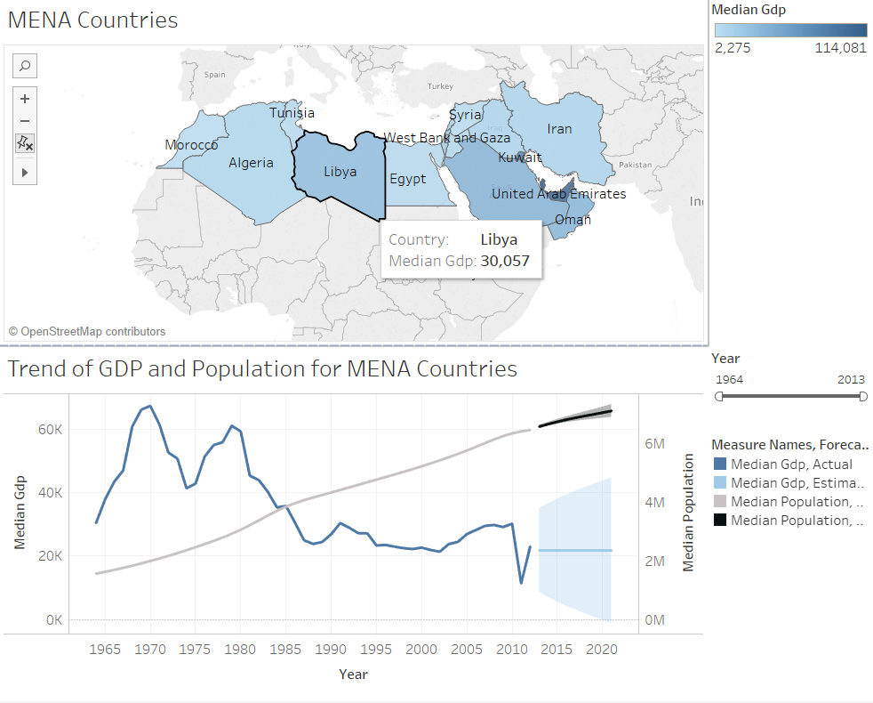
GDP and POPULATION
The population of Libya has been increasing at a constant rate, however, between 2010-2011 there was 65% decrease in the GDP.
The 2011 Libyan Civil War might have resulted in unemployment with respect to the increasing population in the same time frame.
The increase in population cannot meet the growth of employment opportunities along with an ongoing civil war.
According to Okun’s law, increase in unemployment always causes a 2% fall in GDP.
According to our forecasting, the population will increase at the same rate however the GDP will remain stagnant.

Slide 15
CONCLUSION
The dashboards created for the business problem, have helped “Stats & Co” to come up with the following inferences -
The child mortality rate is being influenced by the decrease in GDP with the involvement of a third factor which is income in this scenario.
Low GDPs can be a driving factor for the life expectancy rate based upon the political scenario as well as the public facilities provided by the government.
The population of a country is a tricky factor, the increase in the population can lead to a decrease in GDP due to the increased risk of unemployment(as observed in the case of Libya). However always an increasing population cannot be the reason for the decrement of GDP.
With the help of above listed inferences, “Stats & Co” can create a time series forecasting model for the prediction of either the child-mortality rate or life expectancy or GDP for a specific country by considering the remaining factors as the main drivers depending upon the Client’s needs.
Notes:
Low GDP affects the income and low income leads to lack of fulfillment of the needs and wants of the family which leads to child mortality.
In the case of UAE, inspite of decreasing GDP the life expectancy did not decrease due to excellent services provided by the government, where as a decrease in the gdp of libya lead to a slower rate of increment for the life expectancy.

Slide 16
REFERENCES
Top Causes of Poverty in Libya. (2018, June 20). Retrieved from https://borgenproject.org/causes-of-poverty-in-libya/
Guo, J., & The Washington Post. (n.d.). The relationship between GDP and life expectancy isn't as simple as you might think. Retrieved from https://www.weforum.org/agenda/2016/10/the-relationship-between-gdp-and-life-expectancy-isnt-as-simple-as-you-might-think
Rizvi, A. (2016, May 19). WHO report notes increase in UAE residents' life expectancy. Retrieved from https://www.thenational.ae/uae/who-report-notes-increase-in-uae-residents-life-expectancy-1.196044
Pearson Distribution / Pearson Curves: Definition, Examples. (2017, November 03). Retrieved from https://www.statisticshowto.datasciencecentral.com/pearson-distribution/
O'Hare, B., Makuta, I., Chiwaula, L., & Bar-Zeev, N. (2013, October). Income and child mortality in developing countries: A systematic review and meta-analysis. Retrieved from https://www.ncbi.nlm.nih.gov/pubmed/23824332
Child Mortality. (n.d.). Retrieved from https://data.unicef.org/topic/child-survival/under-five-mortality/
Okun's law. (2019, February 28). Retrieved from https://en.wikipedia.org/wiki/Okun's_law

Slide 17

THANK YOU

